Slide 1
The Athenian Triremes: Democracy and Empire
“A living sea creature, all muscle and appetite and growth, generated the glistening shell of inspiring art, literature and political ideals…”and unleashed a monster.
LORDS OF THE SEA, John R. Hale
Created by Laurie A. Bisconti, redesigned for IEEE REACH
(Based on a review of LORDS OF THE SEA, The Epic Story of the Athenian Navy and the Birth of Democracy, by John R. Hale)

Slide 2
How did the triremes promote democracy and empire in Athens?
Pericles
Delian League
Golden Age

Slide 3
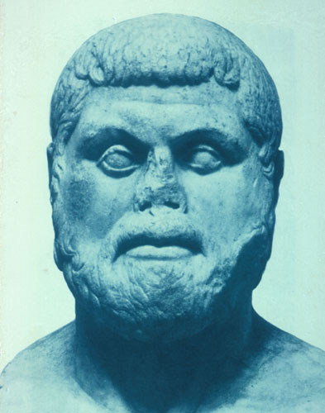
Athens = Thalassocracy
A society wedded to the sea
150 years their city-state strongest navy on earth
Themistocles
Visionary behind the navy
Knew the Persians would seek revenge
“The beat of the oars was the heart beat of Athens in the city’s Golden Age” LORDS OF THE SEAS, John R. Hale
Notes:
The rule started with the Battle of Salamis in 480 BCE and ended in 322 BCE (Peloponnesian war forward to The Age of Reason (The Greek Mind) with the success of Alexander the great. The rest of this time Athens experienced, for the most part, a Golden Age (Hale, Lord of the Seas XXLV). Without it , there would have been no Parthenon, tragedies of Sophocles, Euripides, Plato republic or Politics of Aristotle, Before the Persian war, Athens did not produce any great philosophy, architecture, drama, politics. All of these came after Athens voted to build a navy and transform themselves into a naval power in the early fifth century BCE. The
Golden age of Athens was the age of the Trireme. In their quest for sea rule, they fought many rivals, Persians, Phoenicians, Spartans, Sicilians, Macedonians, and even pirate fleets (Hale, Lord of the Seas, XXV).
Themistocles - It was he who warned of the Persian threat and recognized the need to build 200 ships. He knew the silver mines at Laurium would be the key. Laurium means “Place of Silver” and was 25 miles south from Athens. They had shafts that reached depths of 300 ft. Athenian people owned the mines collectively, but the actual investment and operations were privatized. Soon the silver was booming and created a surplus for distribution. Each citizen was going to receive 10 drachmas. This was a lot of money for landless workers, the citizens who were known as the thetes.
Thetes of the fourth and lowest class numbered about 20,000. most worked for hire in agriculture, manufacturing, or transport. Lacked wealth or influence, but as a mass they were the “demos”’ the “people” at the heart of the Athenian democracy. They were the majority but were barred from holding any elected office. This nondemocratic restriction was also placed on the hoplites. Unlike hoplites, thetes could not be in the Council of 500. So the agenda for the Assembly meeting rested in the hands of the wealthy, and the thetes could only vote yea or nay to proposals that seemed good to members of the upper classes. So when Themistocles stepped in to make his speech, Athens was a democracy in name only. Themistocles begged the Council to not split up the 600,000 drachmas mining revenue, and instead put it to the building of the navy (11) With this amount they could get 100 new war ships. With these new ships and what remained they would have a navy of 200. At a stroke, Athens would become the greatest naval power. And they agreed. (12)

Slide 4
The Wooden Wall
“Athena cannot appease Olympian Zeus
With her pleading words and shrewd metis,
Yet I speak this work, firm as adamant.
Though all else within Attica’s border shall be taken
Even the secret place on divine Kithairon,
Far-sighted Zeus will grant Athena a wooden wall.
It alone shall come through uncaptured; good fortune for you and your children.
But not wait for the host of foot and horse coming overland!
Do not remain still! Turn your back and retreat.
Someday you will yet oppose them.
Divine Salamis, you will destroy many women’s children
When Demeter is scattered or gathered in”
(Oracle, from LORDS OF THE SEA, Hale, pg. 36)
Notes:
p. 36 Say to kids: Let’s take a quick look back where the greatness of the triremes began: As the Persians were advancing, the Greeks went to seek advice of the Delphic Oracle ( like a prophet who sees the future located in Delphi) and foretold of the wooden wall.
Demeter was goddess of wheat, and according to the Greek farmers almanac, her times of scattering and gathering would be either autumn or early summer. (The battle of Salamis was fought in the autumn, LORDS OF THE SEA, Hale, p74)
How does this prophecy seem to reflect what actually happened? How did Themistocles interpret this prophecy in reference to what happened?
Then go through it ….and as a result.
Some had interpreted the wooden Wall as the thorny hedge behind which stood their temples on the acropolis. But no said Themistocles The wooden wall was the navy. Its triremes would be the defense. And that floating wooden wall would bring great profits. So Themistocles pushed through the assembly a series of emergency measures that all citizens regardless of class would man the triremes most as rowers (the heartbeat had begun)
In addition, Athens would be evacuated and it would be Salamis where the wooden wall showed its power. Then page 74. (LORDS OF THE SEA, Hale)
Then direct them to the app
Then pg 72 LORDS OF THE SEA, Hale)
Themistocles’ strategy succeeded. Fast and maneuverable Greek ships and the narrow straits of the Salamis channel proved to be the key to defeating the Persians.
(p,74 LORDS OF THE SEA, Hale) And life was about to change for this city state.
Could “Though all else…it alone shall come through…” be a reference to the impending destruction as revenge for Sardis by the Persians?
If you underlined this, then you interpreted the wooden wall as Themistocles did to be the triremes
Themistocles took this as to evacuate the city not retreat completely
To head the battle to Salamis as they did in 480 BCE, Demeter was the goddess of wheat and according to the Greek farmers almanac the wheat should be scattered in the autumn and this is when the battle occurred

Slide 5
Triremes Rowing to Democracy
Our constitution is called a democracy because power is not in the hands of the minority but of the whole people. When it is a question of settling private disputes, everyone is equal before the law; when it is a question of putting one person before another in positions of responsibility, what counts is not membership of a particular class, but the actual ability that man possesses -Pericles
Notes:
Before Themistocles vision and development of this massive navy, this quote was not true but by the time of Pericles it was. What is the key phrase here that shows the impact of the Triremes? Wait. If you said “actual ability . .” of a man you would be correct. As it was the strength and ability of the oarsmen that became key to individual rights and to the Athenian democracy.

Slide 6
Foundation of Democracy Skill and muscle of the masses
Money to pay jurors and public officials
Eventually thetes (lowest social class) can hold office
Influence decisions that affect their lives directly
Equal protection under the law
Own land & houses in Athens
Notes:
LORDS OF THE SEA, Hale, p. 96 - Or what many call Pericles democracy: radical democracy
It was Pericles who would press for reform a bloodless revolution:
-first he used the money from the treasury to pay jurors. Now poor citizens could leave their daily work to serve on the immense juries of up to 502 that dealt out justice around the Agora. The judiciary was democratized. Then the position of archon was officially opened to the people of the hoplite class. Eventually the archonship was even held by the thetes
p. 120-121***Key: The experiment of democracy ensures that the fruits of the naval victory were shared by all Athenians, transforming the life of even the poorest citizen. The age of the common man had dawned. For the first time on earth, a mass of ordinary citizens, independent of monarchs or aristocracy or religious leasers, was guiding the destiny of a great state.

Slide 7
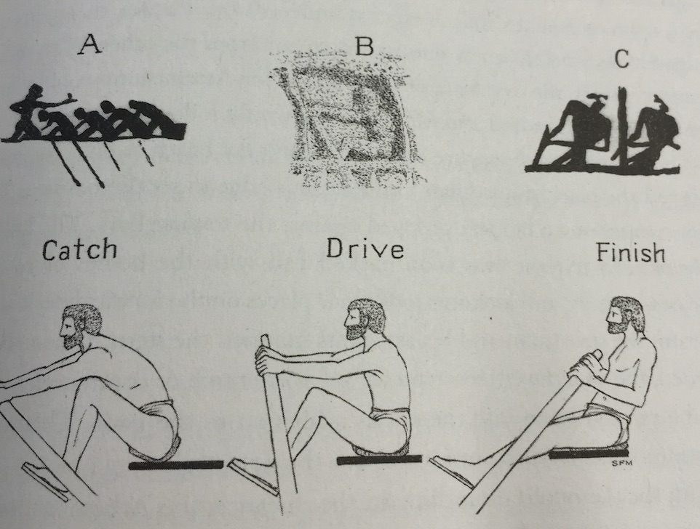
The Oarsmen Skill = Political Power
Freemen, citizens and NEVER slaves
(Athenian ancestry required)
Took pride in the navy
Earned steady pay
Political equality
Metis: Skill, cunning, and intelligence, not courage
I assert that the poor and common people are right to prevail against the well born and the rich, since it is the common who propel the ships and empower the city. –Xenophon
Notes:
Thetes of the fourth and lowest class numbered about 20,000. most worked for hire in agriculture, manufacturing, or transport. Lacked wealth or influence, but as a mass they were the “demos”’ the “people” at the heart of the Athenian democracy. They were the majority but were barred from holding any elected office. This nondemocratic restriction was also placed on the hoplites. Unlike hoplites, thetes could not be in the Council of 500. So the agenda for the Assembly meeting rested in the hands of the wealthy, and the thetes could only vote yea or nay to proposals that seemed good to members of the upper classes. So when Themistocles stepped in to make his speech, Athens was a democracy in name only. Themistocles begged the Council to not split up the 600,000 drachmas mining revenue to the building of the navy (11) With this amount they could get 100 new war ships. With these new ships and what remained they would have a navy of 200. At a stroke, Athens would become the greatest naval power. And they agreed. (12) LORDS OF THE SEA, Hale
Slave Myth: This myth began with the story of Ben-Hur, as with the horns on Viking helmets, the error has taken on a life of its own. (XXVI) Nor did ship life have much in common with the annals of the British navy known through Horatio Nelson, nor through Winston Churchill. There was no lash, in fact, the rowers would have thrown over any officer who tried to whip them. Life on ship was not a hotbed of hostility. No mutinies or gangs.
(LORDS OF THE SEA, Hale, P12.) Themistocles’ proposal that was accepted continued. Key: 100 new triremes would call for 17,000 men to pull the oars. Athens had a fleet of 70 ships. Only by (LORDS OF THE SEA, Hale, p13) “conscripting the citizens of the lowest class, the thetes, could Athens fight a naval battle with the large fleet. That would empower the city’s masses while preserving freedom of the seas (democracy and empire)
LORDS OF THE SEA, Hale, p 95 Key: “The oar and the rowing pad of the common citizen of Athens might seem less poetical and glorious than the hoplite’s shield and spear, but all the world now knew that the city’s power rested on swift triremes and strong crews”
But there was a problem : commoners ruled the seas, but at home they were still second class citizens.
-law allowed him to vote in the Assembly, but could not hold public office.
-Therefore “Athens was less a democracy then a common wealth governed by the richest citizens”
Not the common citizen
Note about courage: LORDS OF THE SEA, Hale, p.246
Triremes ushered in New Era of Warfare
For first time, majority of battles NOT hand to hand combat
So raw courage counted less than technique & orderly execution of mechanical maneuvers
Aim of battle: take out an entire enemy ship
In fact many never saw the enemy (XXXI) “Sitting behind their protective screens of hide or within the wooden hull, the rowers could see nothing of the battle. They could only sit in silence, waiting for the word of command or the signal of the piper.”
“The goal of the fast trireme in battle was to disable, destroy or capture an entire enemy ship ideally with a single ram, so the attack was aimed at equipment not men.
In actions between trireme fleets the skill of the steersman was vital to the success. Athenians called him a kubernetes. The term echoes by the Romans in the Latin gubernator and is ancestral to bother gubernatorial and governor." Ha!
Reliance on Metis:
“Naval tactics favored maneuvers instead to fool the enemy use of t art and cunning and NOT brute force.
Ramming maneuvers and skill of the steersmen were key rather than man-to-man combat (19)
Heavily outnumbered fleets who made use of ramming maneuvers & triremes dominated for 200 years (19)” LORDS OF THE SEA, Hale
Same idea declared by Chinese military safe Sunzi or Sun-Tzu in the Warring States” in China. “Warfare is deception he stated (XXXI) Athenian navy bought this hook line an sinker!”
Ex. Themistocles lured the Persian armada into the narrow straits at Salamis with a false message.
Metis: embraced craft, cunning, skill and intelligence the power of invention and the subtlety of art. See it in Odysseus: Homer’s Iliad on the uses of Metis:
To win the prize, keep metis well in mind.
By tis, not brute force, men fell great oaks.
By metis steersmen on the wine-dark sea
Steady their swift ships through the tearing gale.
By metis charioteer beats charioteer.
p. 20
The triremes demanded much more man power and money than ever before.
Human effort: new levels
-Need hard training at sea for these men.
-Victory belonged to those who were best-drilled and best-disciplined crews, not most courageous.
-Skillful steering, timing and oarsman ship were key. Practice was the only way.
*-Ramming maneuvers changed the world by making the lower-class steersmen, subordinate officers and rowers more important than the propertied hoplite soldiers. (a marine’s spear thrust might eliminate one enemy but a trireme’s ram may take out an entire crew.
-Themistocles wanted it to be fast, light, open and undecked for max speed. And maneuverability. So not designed for large amounts of troops but ramming.

Slide 8
Unifying Spirit
In emergency: all free adult males would serve in the navy
In one case, freed thousands of slaves to man a new fleet and earned citizenship and thus literally “rowing to democracy”
Mobilized an entire city to become “lords of the sea”
Gained true equality with horsemen and hoplites
Notes:
“Had a unifying spirit: (XXX) Like the Vikings and Venetians, Athens built a civilization of seafaring. They navalized their society as Sparta militarized theirs.
All free adult males in times of emergency: fish and poor, citizens and aliens, aristocratic horsemen and common labor (XXVI) In fact, in one case (XXVII) when the Athenian fleet was blockaded in a distant harbor, the Athenians freed thousands of their slaves so that a new fleet could row to the rescue. All these former slaves received citizenship = thus literally rowing to democracy.” LORDS OF THE SEA, Hale
-“Athens alone had mobilized an entire citizen body for the naval effort. They were now riders of the sea.”
-Hoplites traded in their shields and spears for rowing pads and oars.
-for thousands of common citizens the naval expedition gave them for the first time a sense of true equality with horsemen and hoplites
-Oars were great levelers (a good title): rowing demanded perfect unison of action and the discipline forged a spirit of unity (“Rich and poor shared the same callused palms. Blistered buttocks, and stiff muscles as well as the same hopes and fears for the future.”)
“A new unified Athens was being forged on the decks and rowing thwarts of the fleet.”
P28 (LORDS OF THE SEA, Hale)
Conclusion for chapter
-From the mines of Laurium the silver was minted into coins that had likeness of Athena
That money then flowed into the hands of 100 of the wealthiest citizens who organized the shipbuilding campaign.
-That money was then disbursed to the workers: loggers, shipwrights, bronze smiths
They were all making Themistocles vision a reality
In the end : the money returned to those very citizens who voted to give up their 10 drachmas for the common good:
The 100 new triremes that they created changed the Athenians: that sense of common purpose had transformed them
Other notes from LORDS OF THE SEA, Hale
Naval income: p. 126-Pericles took it upon himself to give the navy a peace time routine. Every spring 60 triremes would put to sea crews composed entirely of citizens , 12,000 Athenians. The right to serve meant prove Athenian ancestry: both on father and mother side.
*Athenian citizen ship” a cherished prize a that came with pay for naval service, and rights.
Paid for Golden Age and Age of Reason: 132-133
p. 132
The Athenians Golden Age was a time of power and prosperity but also an age of reason. Attempted to change the fact that most Athenians believed in omens and divination. To counter balance this, Pericles for example welcomed natural historians, city planners, philosophers, military engineers and Astronomers to Athens. Debates over their ideas and teachings. Pericles and Athens tried to maintain a delicate balance between reason and tradition. The city provided public education in political science, rhetoric, philosophy and much more. He called his city the School of Greece. All citizens were expected to engage in discourse: Pericles : We don’t say that a man who takes no part in public affairs minds his own business’ on the contrary, we say that he has not business here at all.
Prosperity
P133
The treasurer of the maritime alliance had earned a surplus of 7000 talents first on Delos and later at Athens. So Pericles proposes his new vision: with this money. Build new temples building to replace those destroyed by Xerxes 30 years prior, wanted a new marble temple which will be known as Parthenon. Surplus naval funds would help pay.
“Without the Athenian navy there would have been no Parthenon, no tragedies of Sophocles or Euripides, no Republic of Plato or Politics of Aristotle. Before the Persian Wars Athens produced no great traditions of philosophy, architecture, drama, political science, or historical writing. All these things came in a rush after the Athenians voted to build a fleet and transform themselves into a naval power in the early fifth century B.C.” (xxiv-xxv).
Aftermath of Persian War
p.94
-With the victory, beautified city as never before. In Agora, planted majestic trees, rich foliage, new colonnaded portico or stoa (I was in there) built to house Athenian paintings. World’s first public art museum. The painted Stoa became a public gathering place and gave rise to the terms Stoic for a school of philosophers who met under a colonnade
Acropolis engineers and masons raised a magnificent buttressed wall to fortify the south slope, At the academy they improved training groups for Athen’s athletes with adqueducts, fountains, shady grove and a running track.
Began the task of joining Athens to the sea with long walls. Ultimately run from the city gates to the Piraeus,
Persians had razed Athens to the ground but in two decades the city was reborn. Xerxes attempt to crush them “had the paradoxial affect of spurring them to new heights of achievement. Became the leader of a mighty maritime league
*Key: Transformation profound: The city was becoming a vast urban stage decorated with sumptuous scenery and the men of the Demos, veterans of many successful campaigns at sea, were at last ready to the the direction of the drama in their own hands.

Slide 9
Citizens of the World
Life linked to the sea=open spirit and free inquiry.
Encouraged foreigners to become resident
Allowed them to build shrines to their gods
Spreading democracy to the world
Notes:
Unlike its neighbors they eagerly welcomed foreigners from overseas to settle as residents. (XXVIII). In fact allowed them to build foreign shrines to their own gods. In fact, among land powers like Sparta and Thebes, the dominance of hoplite phalanx discouraged such liberal thinking. The military regimes were much more xenophobic anti intellectual and suspicious of change.
Study. Com Greeks staged revolutions in the cities they conquered, killing off rich aristocrats and establishing democracies. Persian soldiers would arrive to reinforce a town only to find the gates barred to them while the Greeks had sailed on to attack somewhere else.

Slide 10
Triremes Empire and Dominance
No doubt all this will be disparaged by people who are politically apathetic. But those who, like us, prefer a life of action will try to imitate us. If they fail to secure what we have secured, they will envy us. All who have taken it upon themselves to rule over others have incurred hatred and unpopularity for a time. If one has a great aim to pursue, his burden of envy must be accepted, and it is wise to accept it. Hatred does not last long, but present brilliance will become future glory when it is stored up everlastingly in the memory of mankind. – Pericles to the Athenians
Notes:
What is Pericles saying to his critics? What is the tone? Arrogance and hubris. He is saying everyone else is jealous they will get over it.

Slide 11
LORDS OF THE SEA
medicinal plant and dietary
With the powerful navy, Athens became a maritime empire
establishing colonies and garrisons across the Aegean and Asia Minor.
Big Olive: center of trade, dominated the Mediterranean Sea
Notes:
p. 47 Big Olive; the Piraeus, Athens port city, was the hub of trade that spanned the eastern Med sea, Adriatic, Tyrrhenian, Aegean, and Black seas. At stalls in the Agora sellers offered African ivory, Baltic amber, Chinese silk. Peacocks from Persia, large scale traffic of wine, salt, fish, building stone and timber. Wheat from Russia, Sicily, Egypt.
What value show? arête
p. 115 is as the role of the navy and maritime trade expanded, the Piraeus became a great city in its own right
P 113-114
Center of trade Piraeus overflowed with goods. From Libya ivory, hides, and the medicinal plant and dietary supplement of si;phium. Egypt: papyrus, and sail cloth, Cretan cypress wood, Syria incense. Then it lists all the goods coming from all other ports like Salt fish of black sea, beef ribs form Thessaly, pork and cheese form Syracuse, dates from Phoenicia, raisin and gigs from Rhodes.

Slide 12
Ramming for Compliance
Imperialistic (empire) power abroad
As part of the Delian League, allies had to pay tribute (money)
As the Persians were retreating, Pericles held league by force
Still collecting money and not allowing members to leave
League paying for protection but no more Persian threat
This money was funding the the Golden Age in Athens
The cost of keeping up the navy during peace and war was paid for by tribute of the Allies
Allies no longer had an independent political identity
Absorbed into the Athenian Empire
Notes:
Waging war against allies:
LORDS OF THE SEA, Hale - Iron Fist of Empire: p. 91
Almost from the beginning of the Delian League, Athenians found it necessary to wage war not only against the Persians, but on fellow Greeks. Their rationale: “all those who reaped the benefits of the Athenian alliance – freedom of the seas and freedom from Persian aggression – should join and contribute”
Some then were forced against their will. Some tried to withdraw from the alliance after a number of years. And Athenians came after them blockaded their port and treated them as dangerous rebels. Many had to surrender their fleet and mining rights to Athens and then pay a huge sum of 80 silver talents.
Study.com: But Athens would have none of it. As the head of the Delian League, Athens had become incredibly rich and powerful, establishing colonies and garrisons across the Aegean and Asia Minor. Moreover, the war was just the thing the young democracy needed to cement itself. As we've seen, political power usually came with military usefulness. With the offensive in Persia, suddenly all those poor citizens could make an important contribution to the war effort. They could row triremes, and in a month of rowing they could earn more than in a year of farming.
The other members of the League were less gung-ho about the whole arrangement. Yet they also did not want the angry Persians to be able to come back and take revenge. So, instead of providing ships and crews, they started just providing gold, food or raw materials and letting the Athenians take care of building and running the navy. And just like that, the states who had just fought for their freedom from Persia were now paying tribute to the Athenian empire.
Funding the Golden Age:
Athens: First modern city:
Not ruled by kings or priests or nobles
Ruled by a sovereign democratic Assembly
Had to deal with the same polarities of the modern world: conflicts that pitted east against west (XXXII); liberal against conservative, scientific against religious
And a paradox, the same navy that made Athens a democracy at home (XXXIII) made it an imperialistic power abroad and at times an oppressor of the very cites that they helped to liberate fro the Persians (this is my key theme. Make this the focus. ) The Golden Age was funded in part by payments of tribute that Athens demanded of its maritime subjects and allies. As for the Parthenon, that iconic ruin in pure white marble makes today’s world imagine a serene ancient Athens of lofty visions and classical balance. In fact, at the time of its building the Parthenon was a bitterly controversial project, paid for in part with what Pericles opponents considered to be misappropriated naval funds ( of the Delian League)
Time and water he says, have washed away the bright colors of the Parthenon but also says, Hale, the very importance of the trireme that was the vital force behind the monuments. “A living sea creature, all muscle and appetite and growth, generated the glistening shell of inspiring art, literature and political ideals.
“The beat of the oars was the heartbeat of Athens in the city’s golden Age.” Their epic voyage altered the course of history (XXXIII)

Slide 13
The Trireme Paradox Conclusions
How was the creation of the trireme a “game changer” for Athens?
What is a paradox of the trireme and its influence on Athenian history?
What important themes does the trireme reveal about history?
Notes:
LORDS OF THE SEA, Hale
Had to deal with the same polarities of the modern world: conflicts that pitted east against west (XXXII); liberal against conservative, scientific against religious
And a paradox, the same navy that made Athens a democracy at home (XXXIII) made it an imperialistic power abroad and at times an oppressor of the very cites that they helped to liberate fro the Persians (this is one of the key themes of this inquiry. Focus on this. ) The Golden Age was funded in part by payments of tribute that Athens demanded of its maritime subjects and allies. As for the Parthenon, that iconic ruin in pure white marble makes today’s world imagine a serene ancient Athens of lofty visions and classical balance. In fact, at the time of its building the Parthenon was a bitterly controversial project, paid for in part with what Pericles opponents considered to be misappropriated naval funds ( of the Delian League)
Time and water he says, have washed away the bright colors of the Parthenon but also says, Hale, the very importance of the trireme that was the vital force behind the monuments. “A livings sea creature, all muscle and appetite and growth, generated the glistening shell of inspiring art, literature and political ideals.
Love this : The beat of the oars was the heartbeat of Athens in the city’s golden Age. Their epic voyage altered the course of history (XXXIII)
One of the lessons: After the Spartan victory, Hale notes that Samos (the renegade democracy in exile) held out the longest against Sparta. And they rewarded the Samoans with Athenian citizenship. (What if they would have offered this to all their allies?)
Then can read from 318 as an end
Answers:
On the one hand: the navy made Athens the most democratic society in history
And on the other: the navy made it an imperialistic power abroad and at times, an oppressor.

