Slide 1
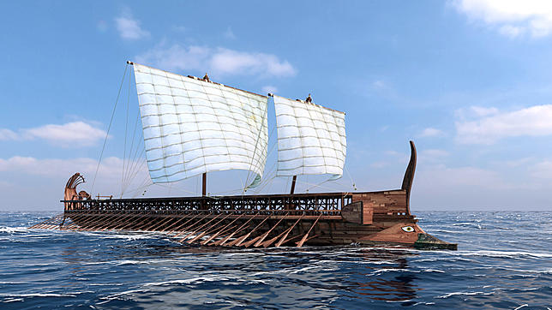
“Lords of the Sea” The Athenian Trireme A Design Challenge
Created by Laurie A. Bisconti,
redesigned for IEEE REACH

Slide 2
The Purpose
To understand the tremendous difficulty to design a lightweight vessel such as the trireme that could carry a crew of 200 and maintain maximum speed and flexibility.

Slide 3
The Problem
Design and build a floating structure to be tested in class to hold as much as possible before capsizing or sinking and travel with maximum speed through the water.

Slide 4
Specifications
Vessel may consist of only foam core and glue/tape
All materials provided in lab
Material used may not exceed 10” x 10”
Vessel must float
Vessel may not rest on bottom of tank when tested
Vessel must have a “hook” (paper clip) on its bow

Slide 5
Consider this
How will we know we have built the craft to hold the maximum cargo load?

Slide 6
Planning
Use the following slides to complete your sketches and calculations in your packet

Slide 7
What is displacement???
Pools
Bathtubs
Kitchen Sinks
Turkey Fryers

Slide 8
Sketch your vessel

Slide 9
Dimension your vessel Length – Width – Height
2”
3”
4”

Slide 10
Determine Volume of Barge
2”
3”
4”
Length x Width x Height = 24 cu in

Slide 11
How many inches in a cubic foot?
1728

Slide 12
Divide Barge Volume by the # of cubic inches in a cubic foot.
2”
3”
4”
24cu” / 1728 = .013 cubic feet

Slide 13
The weight of water
64 pounds per cubic foot

Slide 14
Determine pounds of water displaced by the barge.
Multiply Cu. Ft. of barge by weight of water per cubic foot
.013 x 64 = .832 pounds displaced

Slide 15
Determine the mass of the barge
Approximately 100 grams
2”
3”
4”

Slide 16
How many grams are in a pound?
1 pound = 453.6 grams

Slide 17
Convert grams to pounds
100 / 453.6 = .22 pounds

Slide 18
Subtract weight of barge from weight of displaced water to find penny load.
.832 - .22 = .612 pounds of pennies

Slide 19
Convert penny load lbs into mass
.612 x 453.6 = 277 grams of pennies

Slide 20
What is the mass of a penny?
2.78 grams

Slide 21
Divide allowable penny mass by the mass of one penny to determine the number of pennies the barge can hold
277 / 2.78 = 99 pennies

Slide 22
Why could this number be less?
Workmanship
Loading
Other variables

Slide 23
Now that you have a plan
You and your design team will meet to build your vessel.

